Slide 1
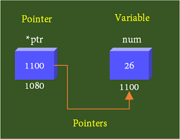
POINTERS
Pointer is a variable which holds the address of another variable
int num = 26;
int* ptr = &num; // p is a pointer
ptr is pointer storing the address of variable num
i.e. 1100

Slide 2
DECLARATION OF POINTER VARIABLE
Syntax : datatype *ptr-name;
  Here, datatype is the pointer's base type; it must be a valid C data type and ptr-name is the name of the pointer variable.
  Ex. int *ip;
Type of Pointers:
int *ip; (integer pointer) -- > /* pointer to an integer */
float *fp; (float pointer) -- > /* pointer to a float */
double *dp; (double pointer) -- > /* pointer to a double */
char *ch (char pointer) -- > /* pointer to a character */

Slide 3
PROGRAM TO ILLUSTRATE A POINTER
#include <stdio.h>
int main()
{
  int *p, a;
  printf("enter the value of a \n");
  scanf("%d",&a);
  ptr = &a; /* address of a is assigned to p */
  printf("Value of a is : %d", *p); /* show a's value using p variable */
  return 0;
}

Slide 4
Q)what will be the output of the following code?
#included<stdio.h>
int main()
{
  int x = 10;
  int y = 20;
  int *ptr1 = &x;
  int *ptr2 = &y;
  ptr1 = ptr2;
  printf("%d %d", *ptr1, *ptr2);
  return 0
}
a) 10 20
b) 20 20
c) 10 10
d) 20 10

Slide 5
Q)what will be the output of the following code?
#included<stdio.h>
int main()
{
  int x = 10;
  int y = 20;
  int *ptr1 = &x;
  int *ptr2 = &y;
  ptr1 = ptr2;
  printf("%d %d", *ptr1, *ptr2);
  return 0
}
a) 10 20
b) 20 20 *(Correct option)
c) 10 10
d) 20 10

Slide 6
Q)what will be the output of the following code?
#include<stdio.h>
int main(){
int a = 25, b;
int *ptr, *ptr1;
ptr = &a;
ptr1 = &b;
b = 36;
printf("%d %d",*ptr, *ptr1);
return 0;
}
A. 25 45632845
B. Run time error
C. Compilation Error
D. 25 36

Slide 7
Q)what will be the output of the following code?
#include<stdio.h>
int main(){
int a = 25, b;
int *ptr, *ptr1;
ptr = &a;
ptr1 = &b;
b = 36;
printf("%d %d",*ptr, *ptr1);
return 0;
}
A. 25 45632845
B. Run time error
C. Compilation Error
D. 25 36
Option: D
Explanation
ptr holds the address of a variable A and ptr1 holds the address of a variable B . The value of A is 25 and B is 36

Slide 8
BENEFITS OF USING POINTERS IN C
Pointers used to access the address of the variable.
Pointers are more efficient in handling Arrays in C and Structures in C.
It reduces length of the program and its execution time as well.
It allows C language to support Dynamic Memory management.
Pointers are dynamic variables.
Pointers are used for dynamic memory allocation.
A pointer enables us to access a variable that is defined outside the function.
Pointers are more efficient in handling the data tables.
Pointers are used in data structures in (linked organization of data)

Slide 9
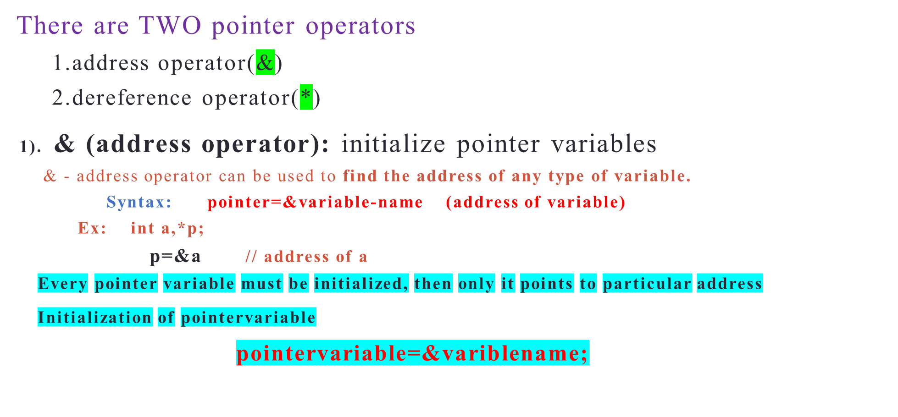
POINTER OPERATORS

Slide 10
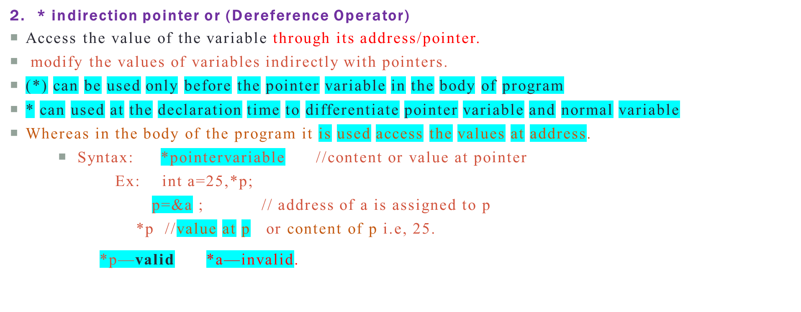

POINTER OPERATORS

Slide 11
POINTER ARITHMETIC IN C
We can perform the following arithmetic operations on the pointers.
  Increment(++)
  Decrement(--)
  Addition(+)
  Subtraction(-)
  Comparison(==)

Slide 12
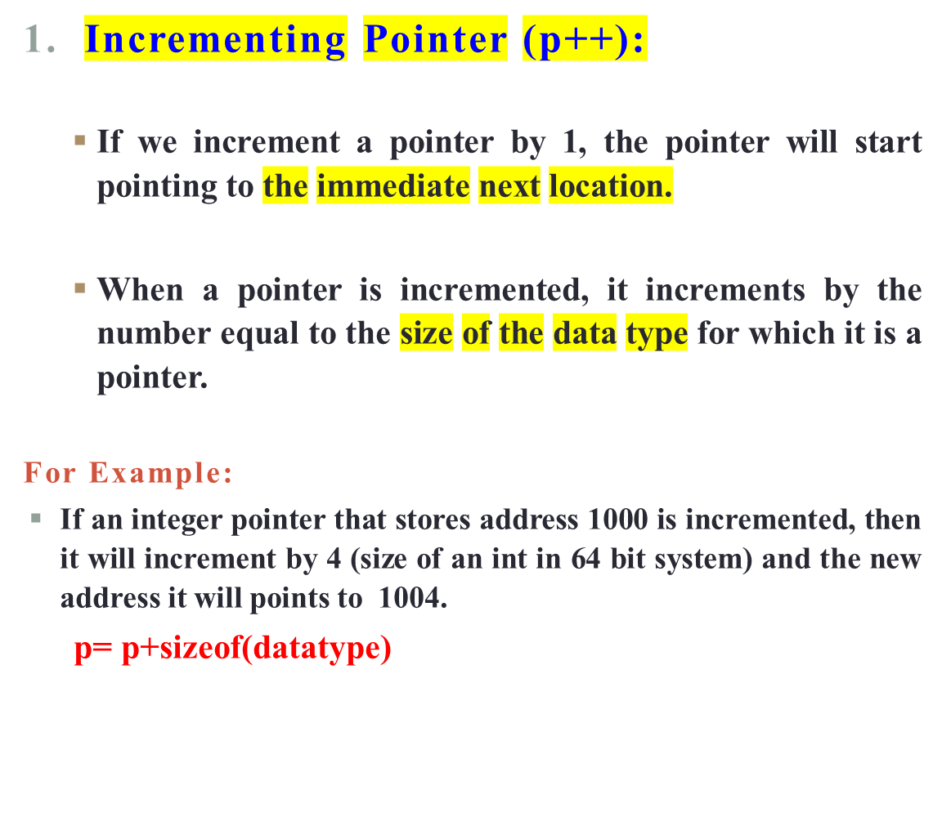
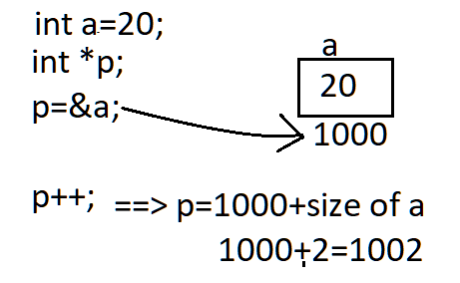

POINTER ARITHMETIC IN C

Slide 13
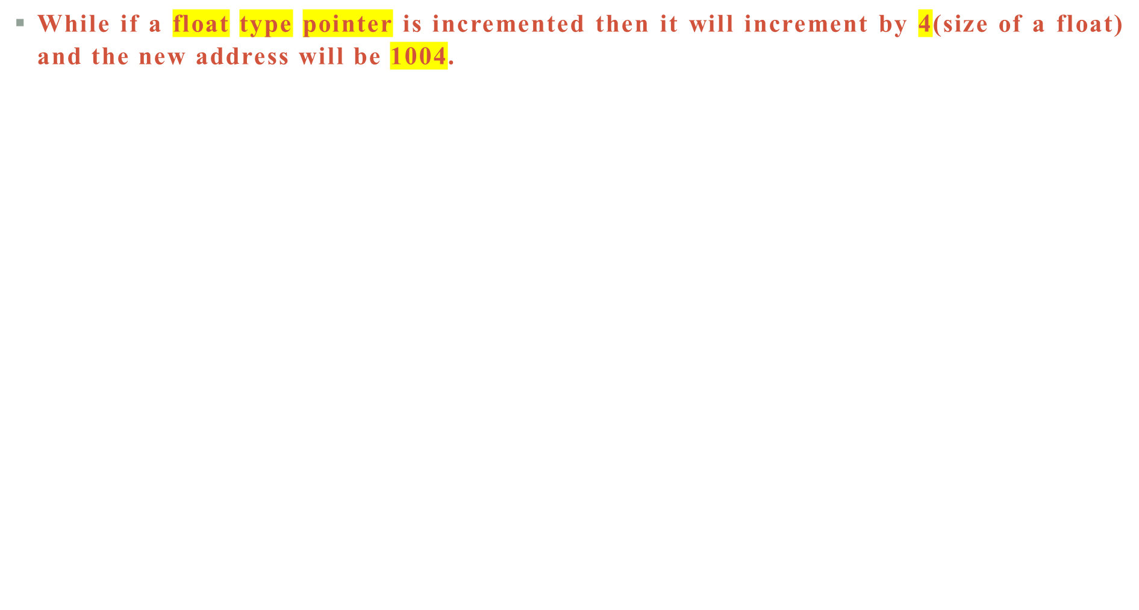
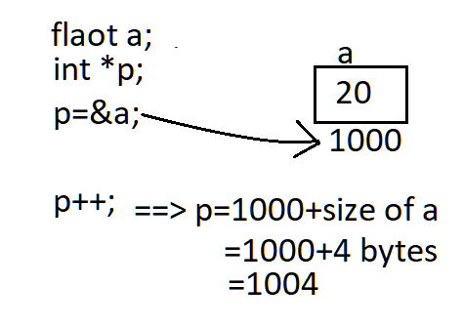
POINTER ARITHMETIC IN C

Slide 14
POINTER ARITHMETIC IN C
  Write a program for pointer increment

Slide 15
POINTER ARITHMETIC IN C
  // C program to illustrate pointer incrementing pointer
  #include <stdio.h>
  int main()
  {
  int a=20;
  int *p; // Pointer to an integer
  p=&a; // Pointer stores the address of a
  printf("Pointer before Increment: ");
  printf("%p \n", p);
  p++; // Incrementing pointer ptr1;
  printf("Pointer after increment: ");
  printf("%p \n", p);
  return 0;
  }

Slide 16
Q.What will be the output of the following code?
#included<stdio.h>
int main()
{
int x = 50;
int *ptr1 = &x;
int *ptr2 = &x;
int y = ++*ptr2 ;
printf("%d %d", ++*ptr1, y);
eturn 0;
}
a) 52 51
b) 50 50
c) 51 52
d) 51 50

Slide 17
Q.What will be the output of the following code?
#included<stdio.h>
int main()
{
int x = 50;
int *ptr1 = &x;
int *ptr2 = &x;
int y = ++*ptr2 ;
printf("%d %d", ++*ptr1, y);
eturn 0;
}
a) 52 51 *(Correct option)
b) 50 50
c) 51 52
d) 51 50

Slide 18
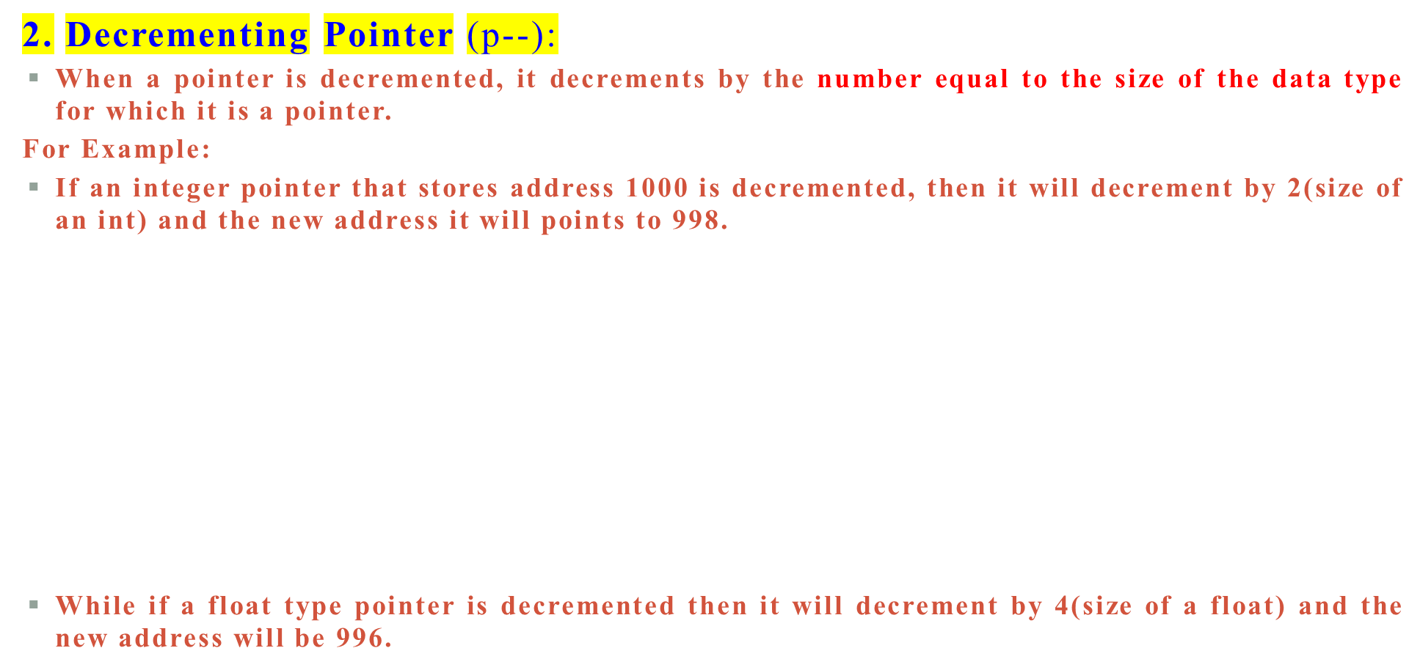
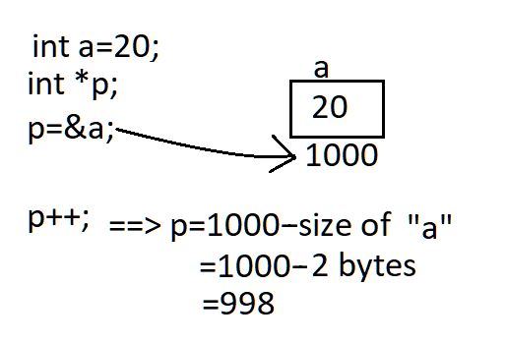
POINTER ARITHMETIC IN C
For 32 bit system the size of int is 2bytes
=1000-4bytes=996 for 64 bit system size of int is 4bytes

Slide 19
POINTER ARITHMETIC IN C
// C program to illustrate pointer decrementing pointer
#include <stdio.h>
int main()
{
int a=20
int *p; // Pointer to an integer
p=&a; // Pointer stores the address of a
printf("Pointer before decrement: ");
printf("%p \n", p);
p--; // decrementing pointer p;
printf("Pointer after decrement: ");
printf("%p \n", p);
return 0;
}

Slide 20
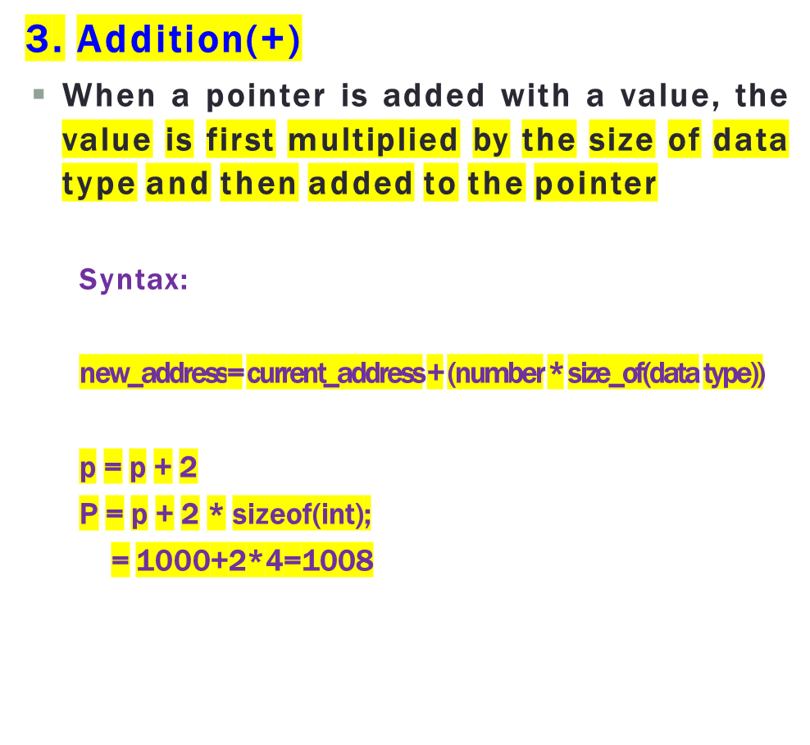
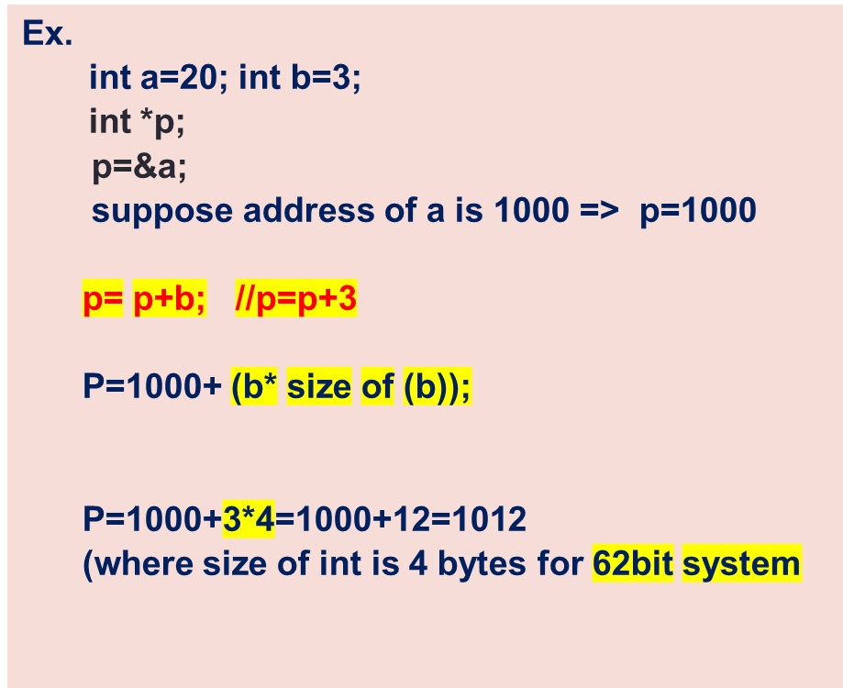
POINTER ARITHMETIC IN C

Slide 21
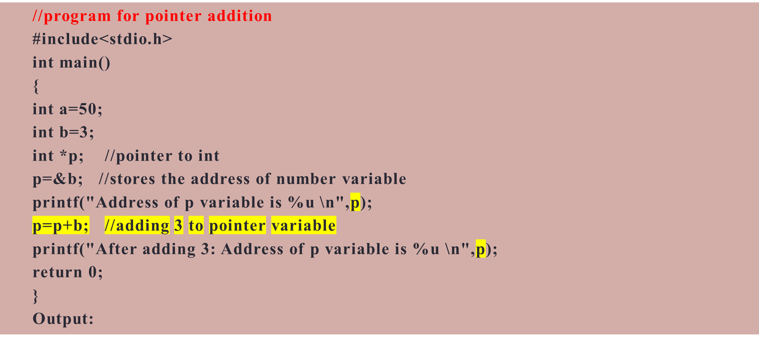

POINTER ARITHMETIC IN C

Slide 22
POINTER ARITHMETIC IN C
  Q) WAP program to add two numbers using pointers.
  Input
  Input num1: 10
  Input num2: 20
  Output
  Sum = 30

Slide 23
PROGRAM TO ADD TWO NUMBERS USING POINTERS.
#include <stdio.h>
int main()
{
int num1, num2, sum;
int *ptr1, *ptr2;
ptr1 = &num1; // ptr1 stores the address of num1
ptr2 = &num2; // ptr2 stores the address of num2
printf("Enter any two numbers: ");
scanf("%d%d", ptr1, ptr2);
sum = *ptr1 + *ptr2;
printf("Sum = %d", sum);
return 0;
}

Slide 24
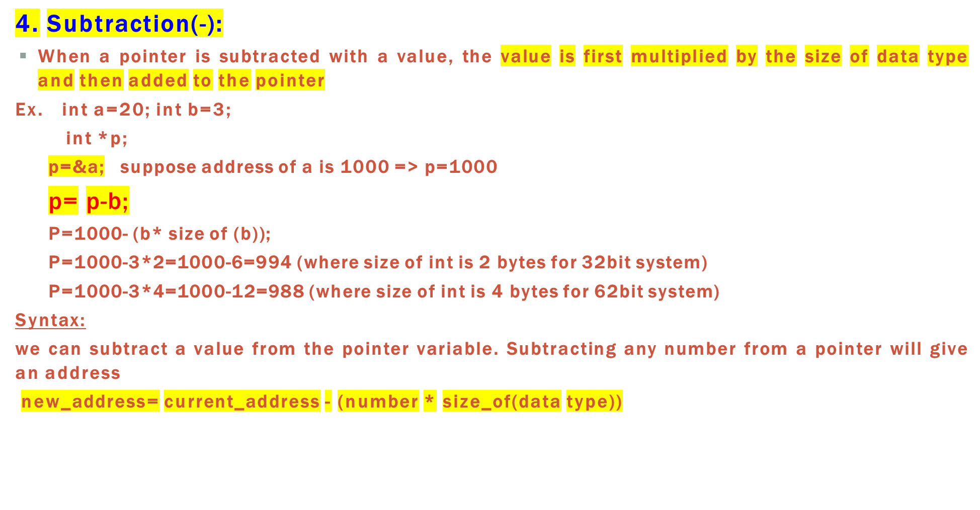
POINTER ARITHMETIC IN C

Slide 25
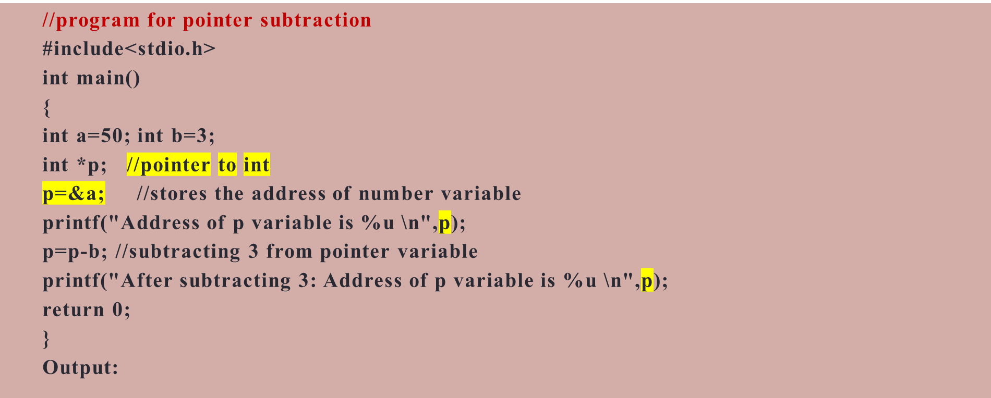
POINTER ARITHMETIC IN C

Slide 26
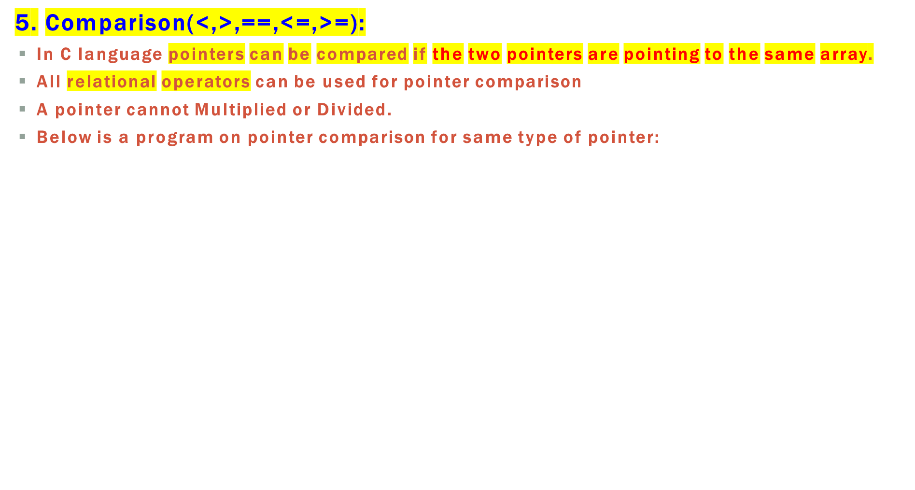
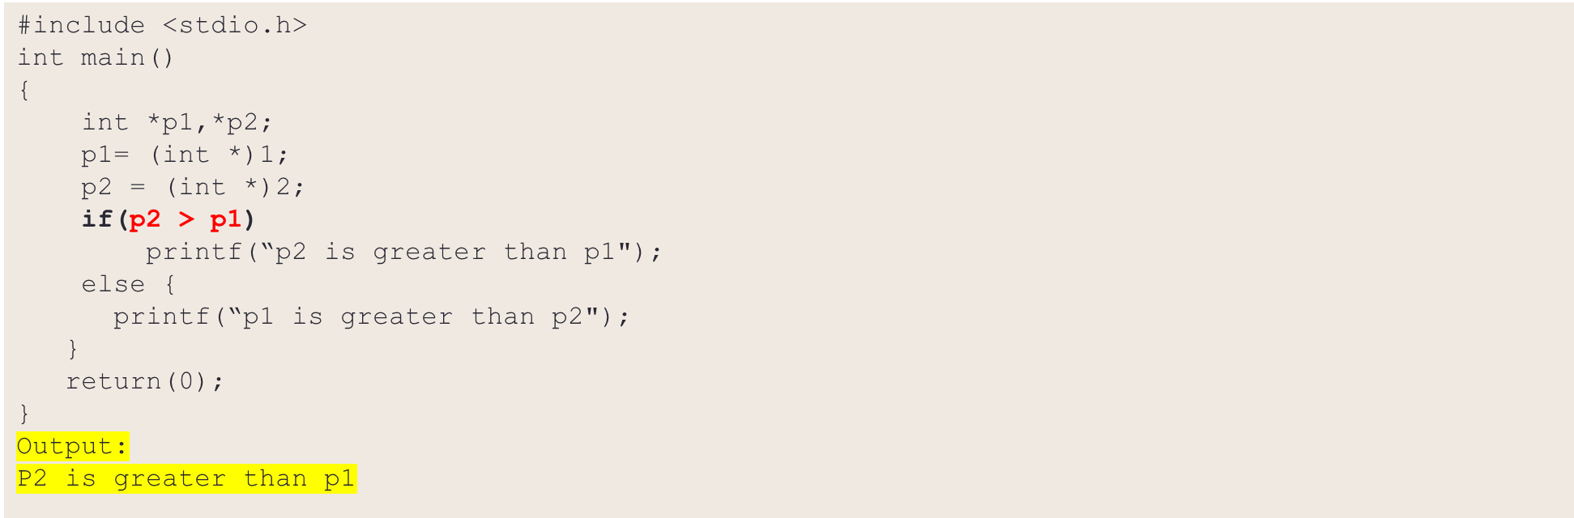
POINTER ARITHMETIC IN C

